Slide 1
BREAST CANCER PREDICTION
~AI project (prof:Vivek sir)

Slide 2
Contents
Introduction
Problem statement
Classification models used
Confusion matrix for accuracy of each model
Dataset used
Best model
Future scope

Slide 3
Introduction
AI can analyze complex data patterns from mammograms and clinical records, aiding in the identification of tumors at an earlier, more treatable stage. This early intervention can reduce the need for aggressive treatments and improve the quality of life for those affected. Additionally, AI-driven predictions can help healthcare providers allocate resources more effectively and offer personalized care to patients.

Slide 4
Problem statement
The problem statement is to use a breast cancer dataset to uncover and analyze meaningful data patterns. These patterns are crucial for developing an accurate and reliable predictive model. The goal is to create a tool that can aid in the early detection of breast cancer, enabling timely medical intervention and improving prognosis assessment. By identifying relevant data patterns, we seek to enhance our understanding of the disease and develop a robust tool for healthcare practitioners and researchers to support improved patient care and outcomes.

Slide 5
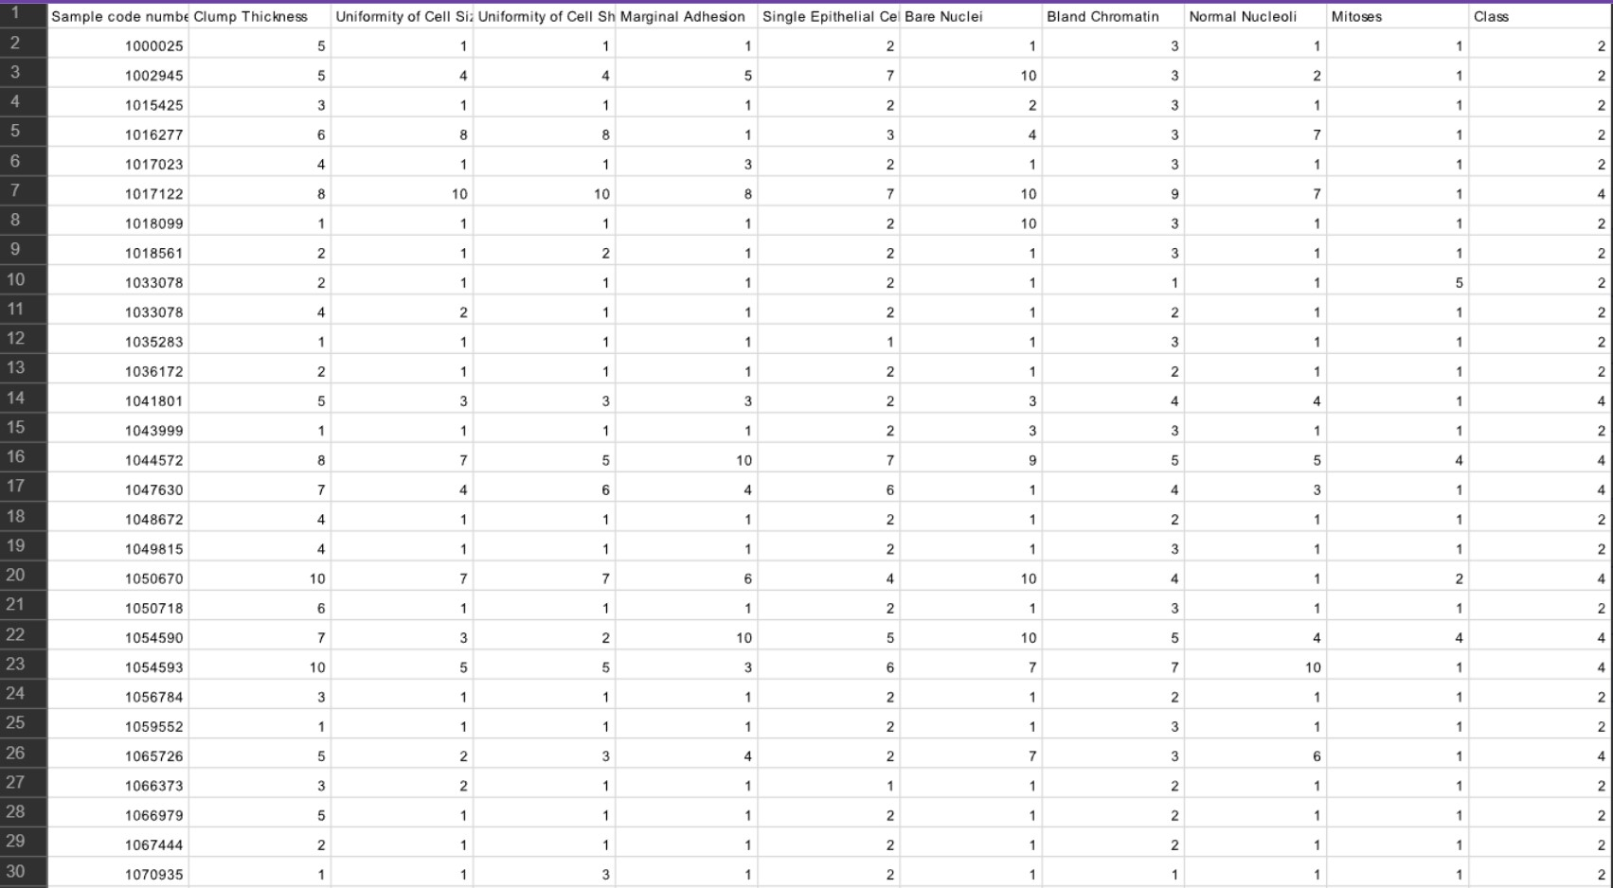
Dataset used

Slide 6
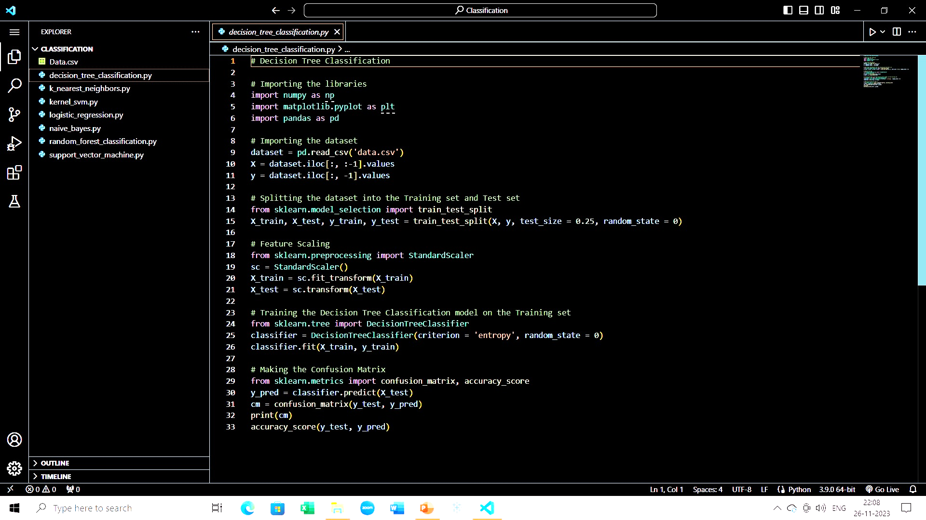
Classification models used: Decision tree

Slide 7
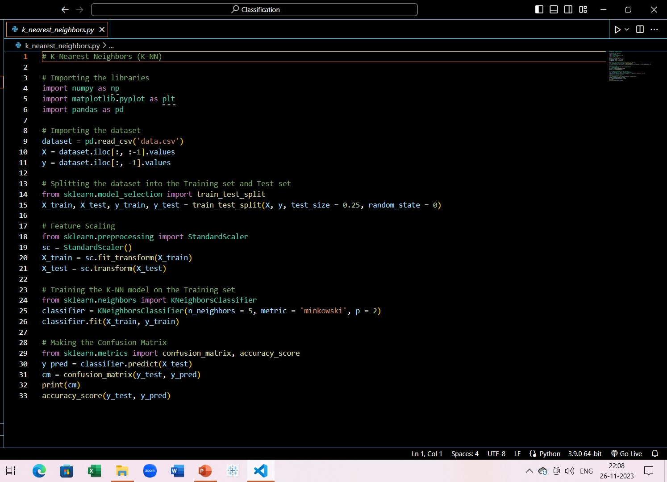
K-Nearest Neighbour

Slide 8
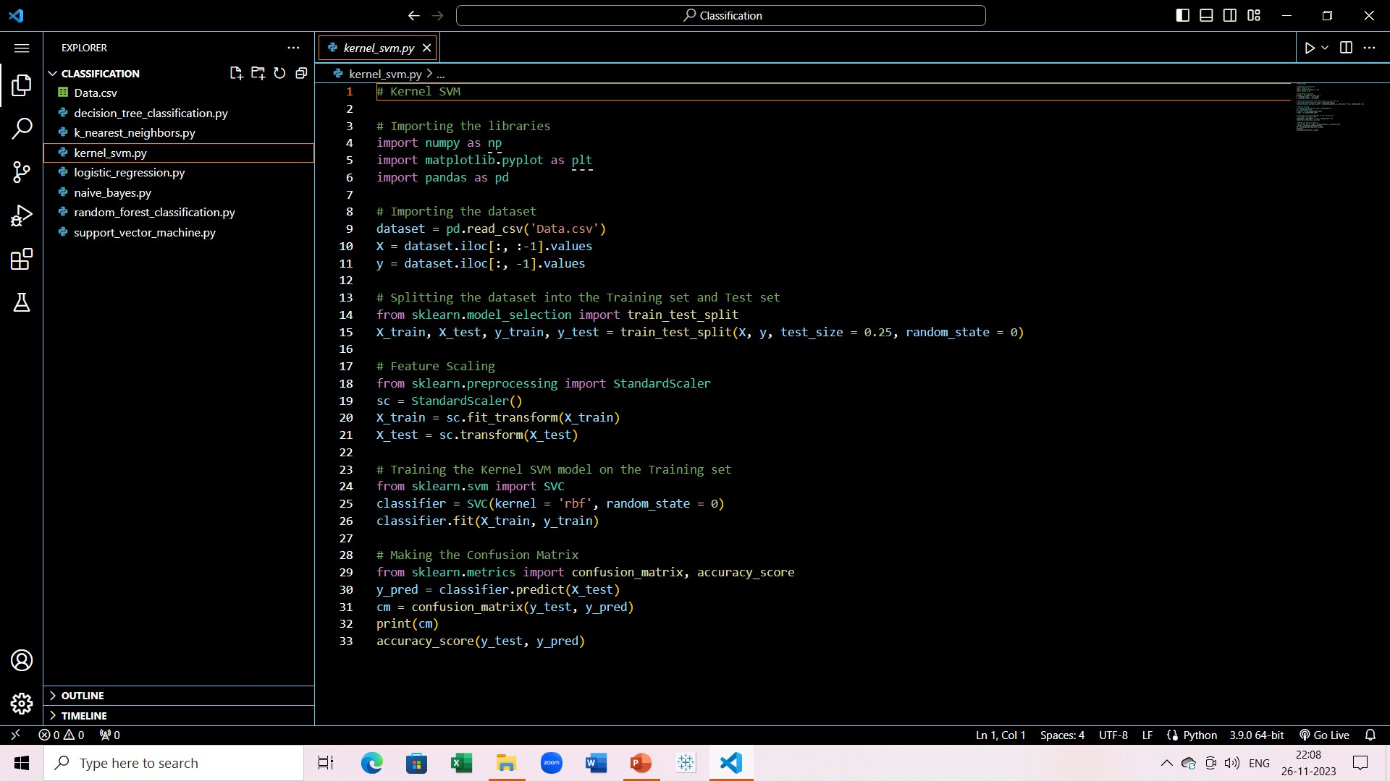
Kernel SVM

Slide 9

Logistic Regression

Slide 10
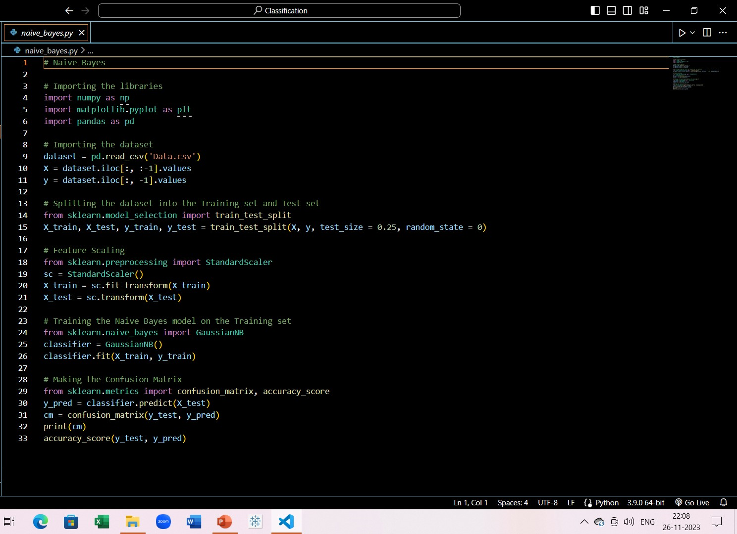
Naïve Bayes

Slide 11
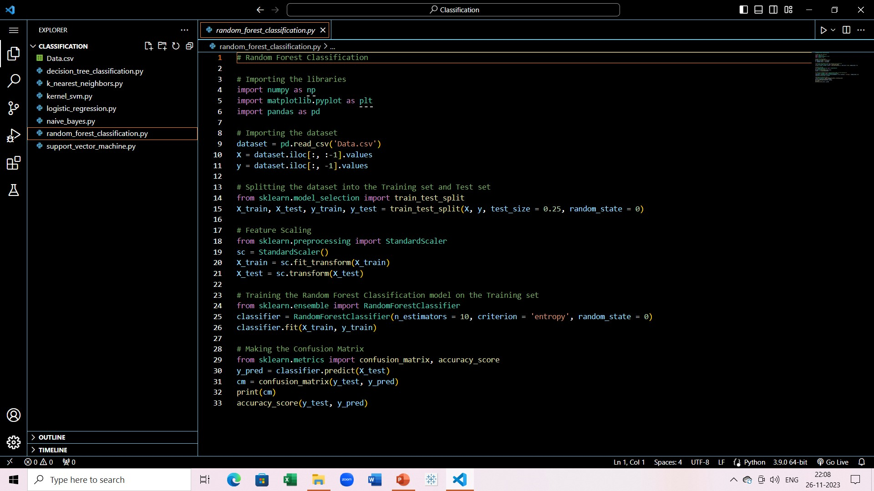
Random Forest

Slide 12
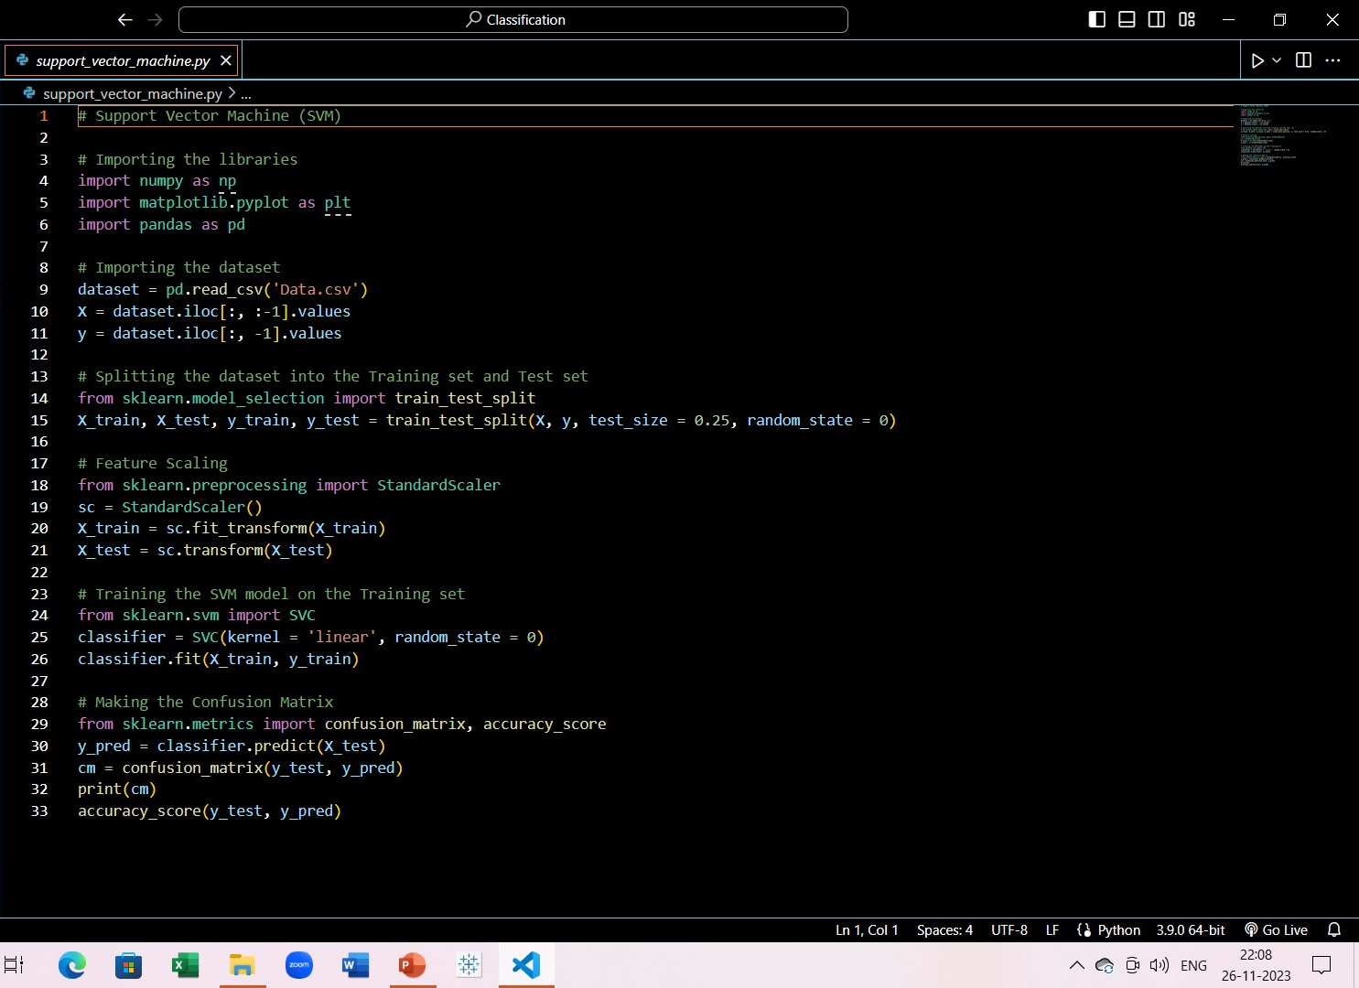
Support Vector

Slide 13
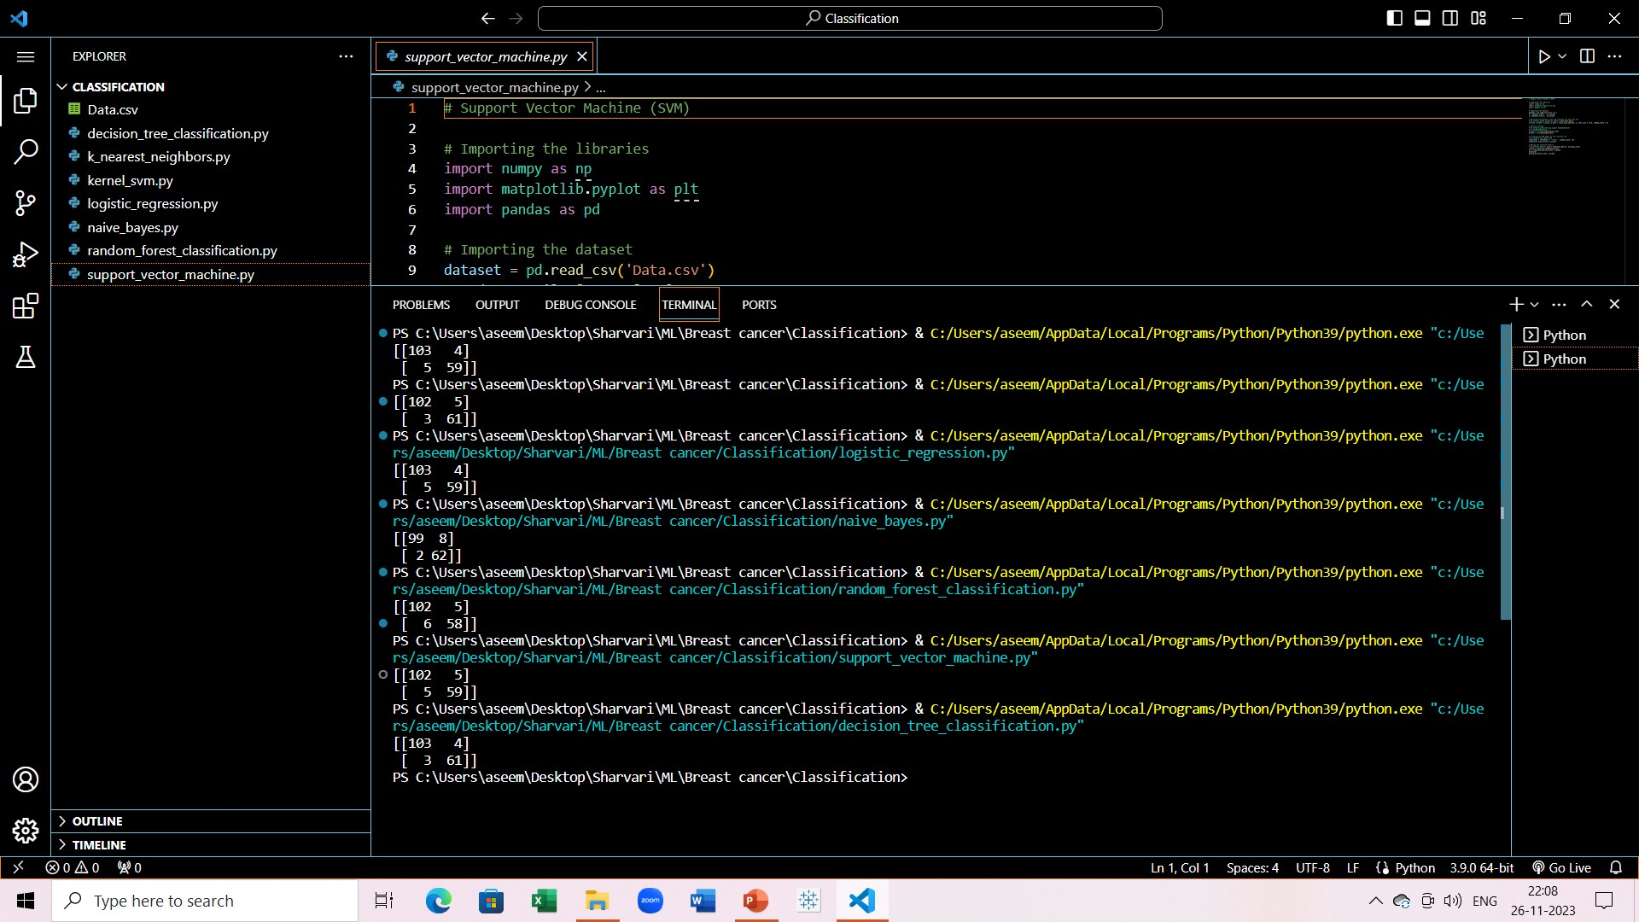
Confusion matrix for each model

Slide 14
Best model selection
Clear Winner: Decision Tree

Slide 15
Future scope
Currently we are only using ML models, and training the model on textual data and figures only
After this is done successfully, we can go into DL and use mammograms to and train and build CNNs to detect breast cancer along with textual data

Slide 16
Thank You

